Slide 1
MATH 5470 Project 1: Tree-Based Classification on Home Credit Default Risk
TSANG Wai Lok,
HUNG Ka Yiu,
Gamage N. D. S.
{wltsangac, kyhungad, dsgn}@connect.ust.hk

Slide 2
Outline
Dataset
Tree Based Models
Evaluation
Findings & Insights

Slide 3
Motivation and Data Introduction
Trusted lenders have positive loan experience
Goal: Assess whether ensemble methods significantly outperform a vanilla decision tree

Slide 4
Dataset Overview
Data source: Home Credit Risk competition(Kaggle)
Binary classification
Dataset features: mix of categorical and numerical, complex interactions.
Unbalanced.
Large size of data: More than 120 features and 300000 rows.

Slide 5
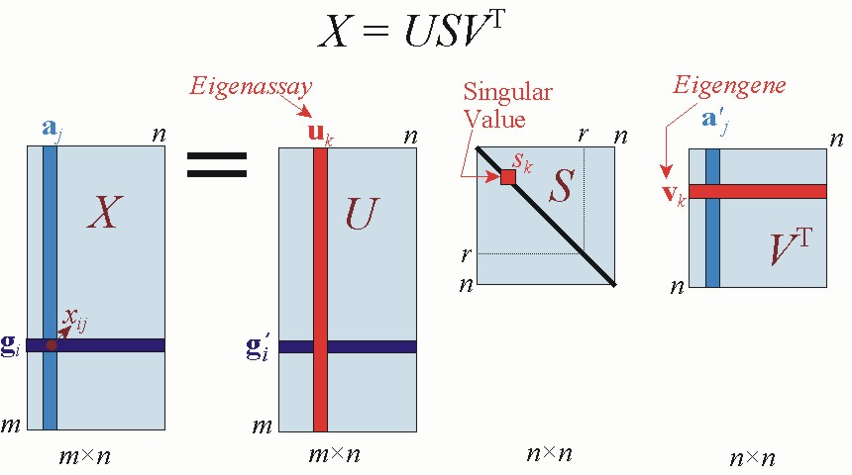
Methodology: Preprocessing
Fill nan value (categorical: mode, non-categorical: mean)
One-hot encoding
Scaling for PCA
Dimension Reduction by PCA

Slide 6
Methodoloy: Models Building
Models compared: 1.Vanilla Decision Tree
2.Random Forest
3.AdaBoost
Hyperparameter tuning: Grid search with 3 fold cross validation using the one standard error rule

Slide 7
Decision Tree Baseline
Single tree with impurity measures: Gini index & cross entropy
Tree depths: 5, 7 and 8
Tends to overfit high-dimensional, noisy data

Slide 8
Random Forest
Bootstrap aggregating multiple trees
Random feature selection at each split mitigates correlated predictors
Number of estimators:200,250,300

Slide 9
AdaBoost
Sequentially builds weak learners focusing on errors
Re-weights samples to target misclassified, hard cases
Number of estimators: 50, 100

Slide 10
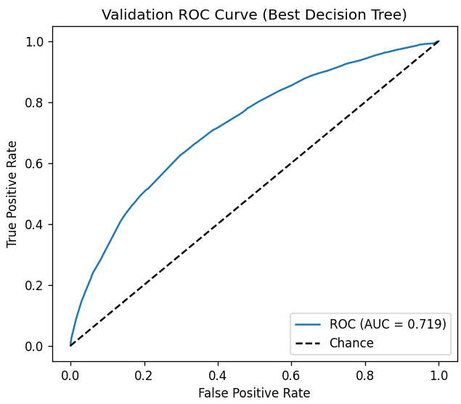
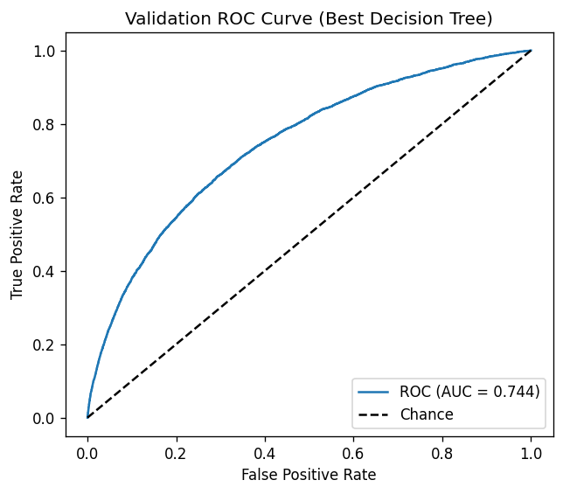
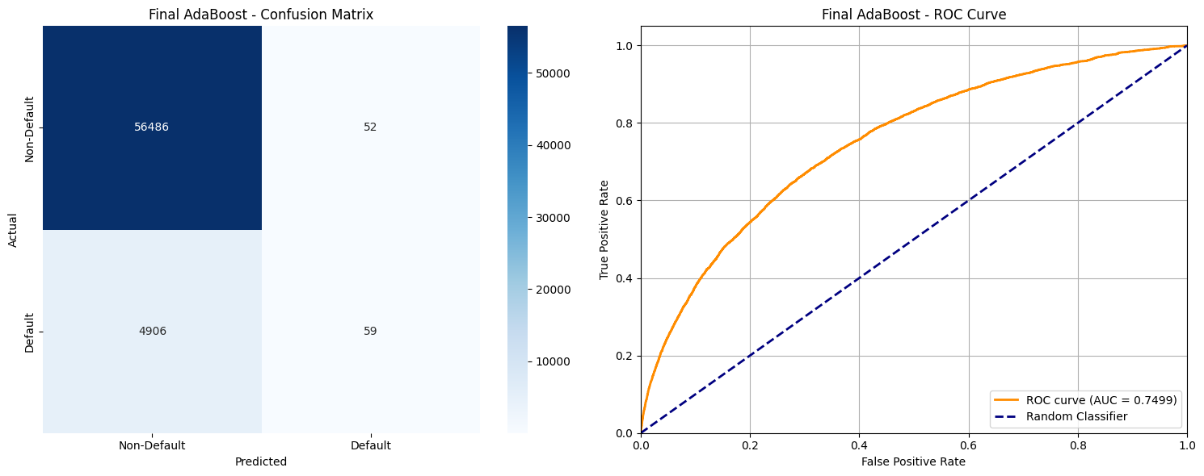
Result: ROC
Decision Tree
AUC=0.719
Random Forest
AUC=0.744
AdaBoost
AUC=0.7499
AdaBoost returns the highest AUC value!
Reduce the variance!

Slide 11
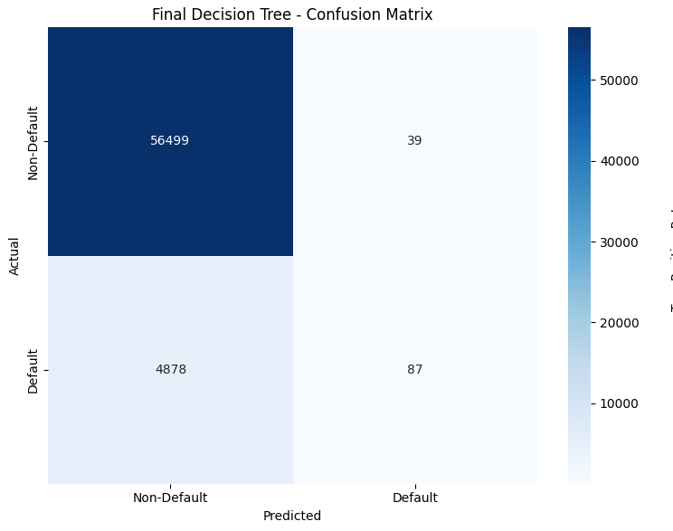
Result: Confusion Matrix (Vanilla Decision Tree)
TP=56499
FP=39
FN=4878
TN=87

Slide 12
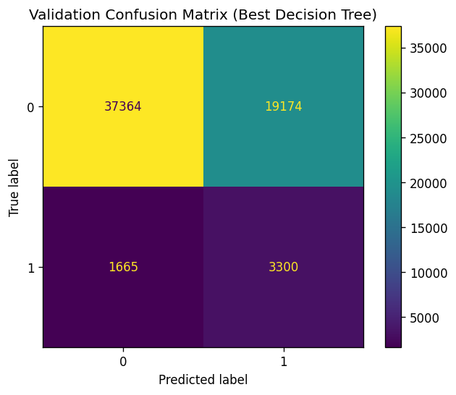
Result: Confusion Matrix (Random Forest)
TP=37364
FP=19174
FN=1665
TN=3300

Slide 13
Result: Confusion Matrix (AdaBoost)
TP=56486
FP=52
FN=4906
TN=59

Slide 14
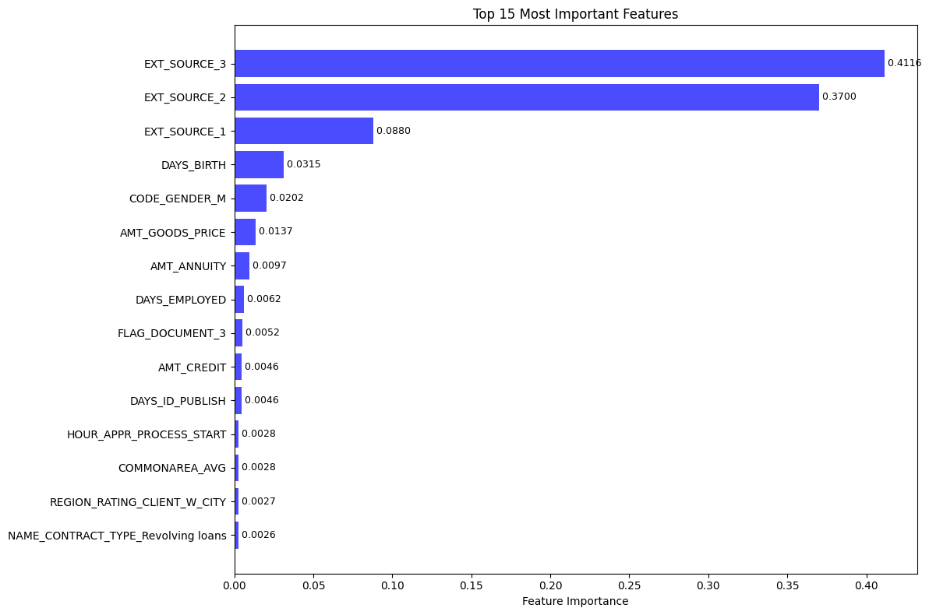
Result : Features Importance (Decision Tree)

Slide 15
Result : Features Importance (Random Forest)

Slide 16
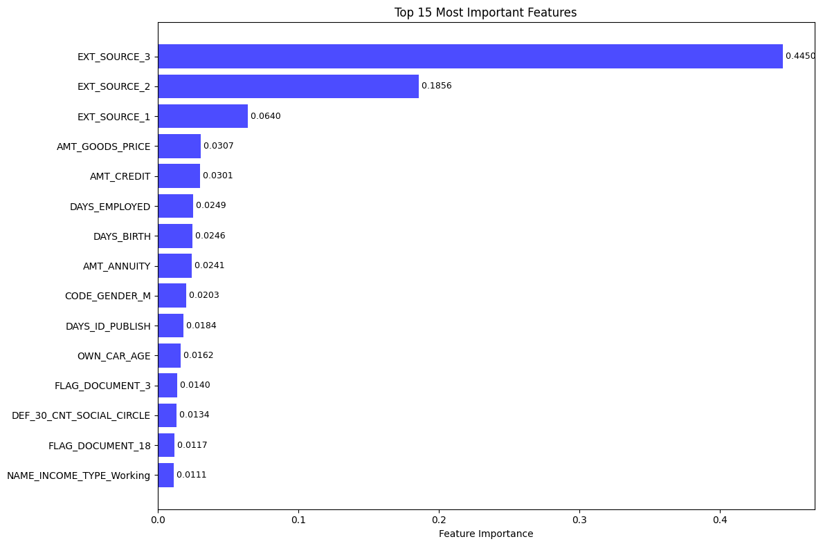
Result : Features Importance (AdaBoost)

Slide 17
Summary of feature importance
Ext_sources 1,2, 3 are most important.
AMT_Good price in the 4th in Adaboost, not in others,

Slide 18
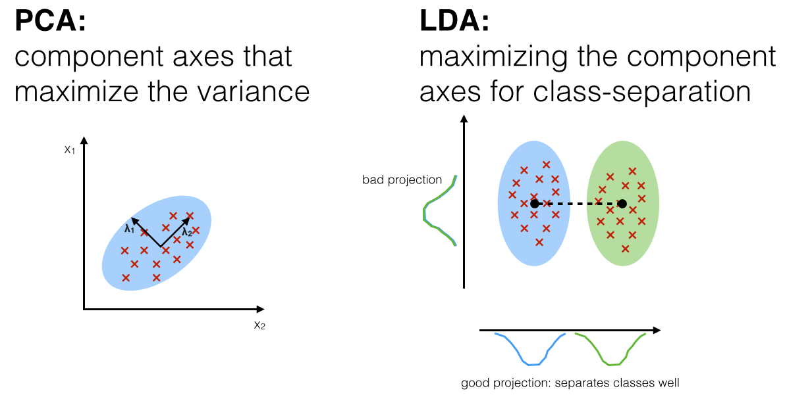
Future Improvement
LDA, t-SNE, kernel PCA?
Is PCA really need for the tree method?
Exploration of unsupervised learning?
Clustering?

Slide 19
References
Wall, M. E. (2025). Singular value decomposition and principal component analysis. Binghamton.edu. https://casci.binghamton.edu/publications/WallSVD2003.html
FISHER, R. A. (1936). THE USE OF MULTIPLE MEASUREMENTS IN TAXONOMIC PROBLEMS. Annals of Eugenics, 7(2), 179–188. https://doi.org/10.1111/j.1469-1809.1936.tb02137.x

Slide 20


