Slide 1
Dimensionality Reduction of Face Order Problem Using Non-linear Embedding Methods
SUN, Jing ; jsunav@connect.ust.hk, MAE, HKUST
LUO, Shuang; sluoae@connect.ust.hk, MAE, HKUST
YU, Zhijie; zyuak@connect.ust.hk, CIVL, HKUST

Slide 2
Outline
Background description
MDS-embedding: algorithm & results
Isomap-embedding: algorithm & results
LLE-embedding: algorithm & results
Diffusion Map: algorithm & results
Summary
CSIC 5011 Final project SUN Jing, LUO Shuang, YU Zhijie 2

Slide 3
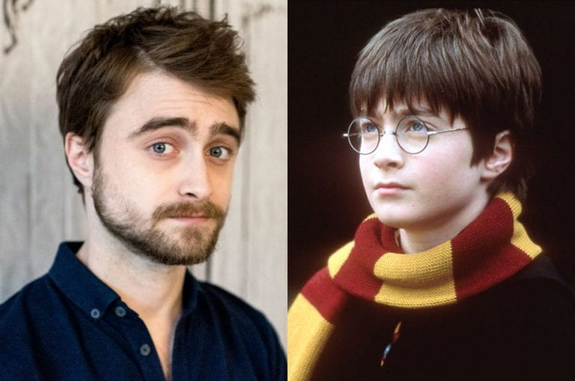
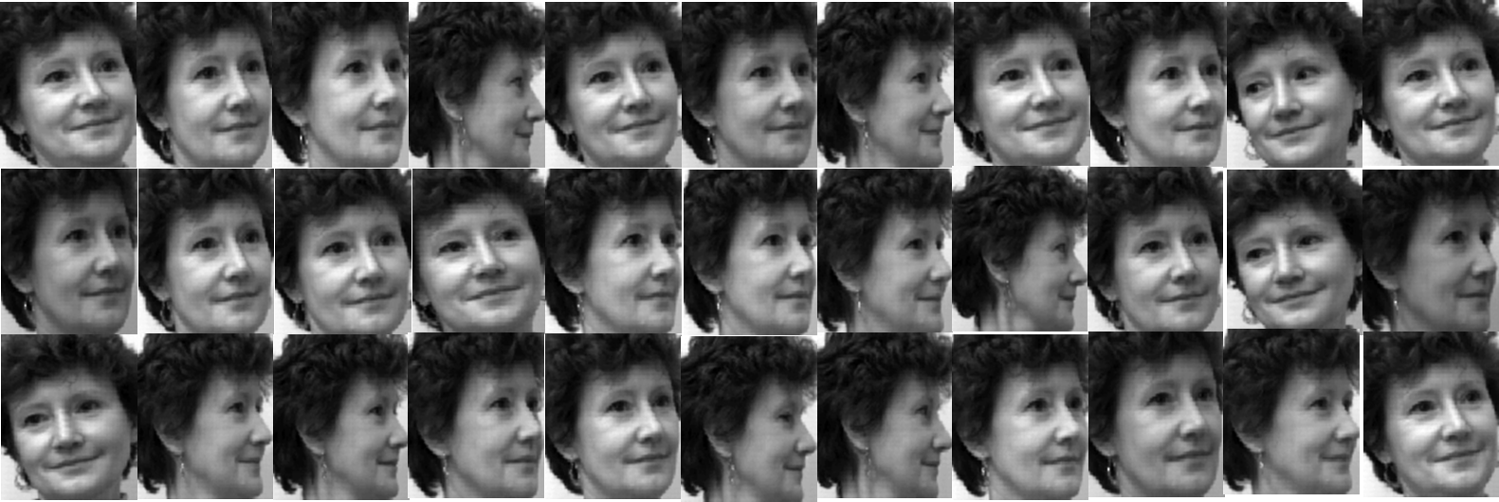
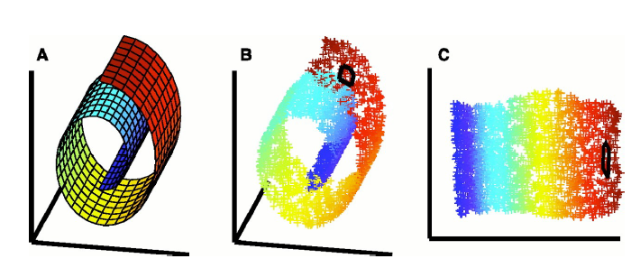
Background
Public face data
Problem Description
Nonlinear Dimensionality Reduction
Target
Use dimensionality reduction methods to judge the similarities and detect the differences of these images.
Compare different algorithms including MDS, Isomap, LLE and Diffusion Map.
CSIC 5011 Final project SUN Jing, LUO Shuang, YU Zhijie 3

Slide 4
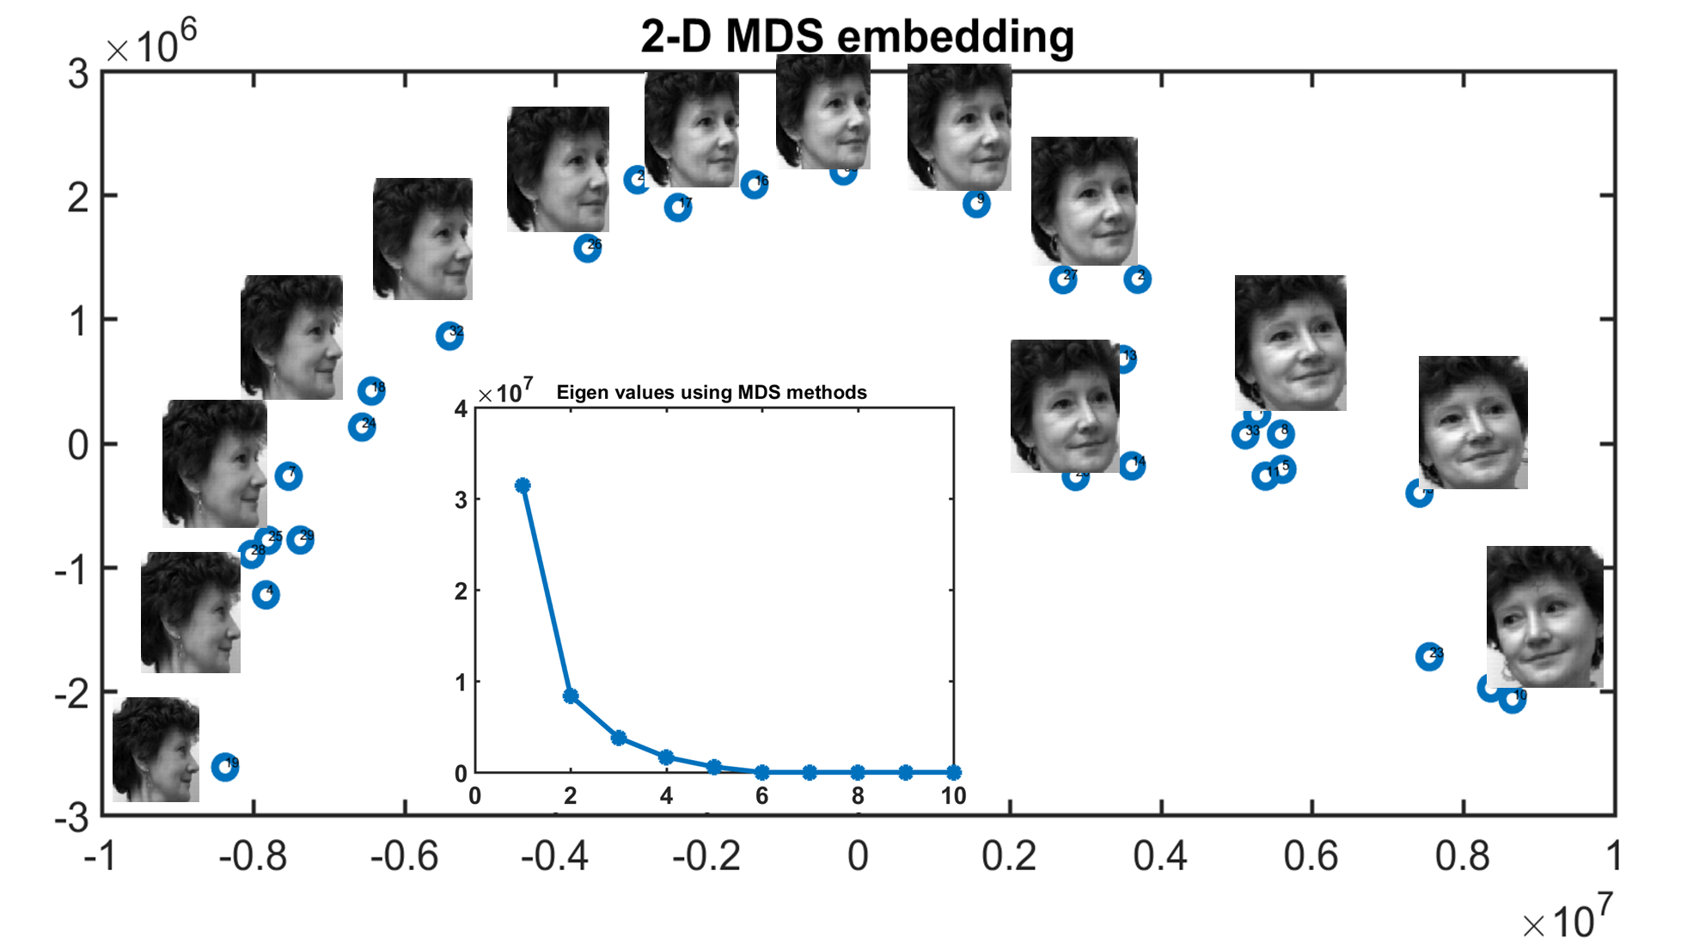
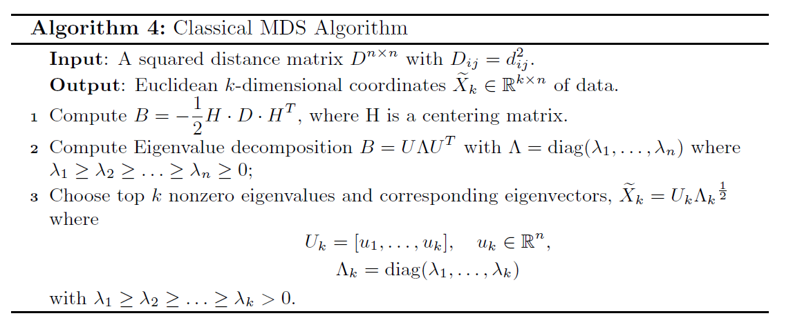
MDS-embedding: algorithm & results
Algorithm
Results
CSIC 5011 Final project SUN Jing, LUO Shuang, YU Zhijie 4

Slide 5
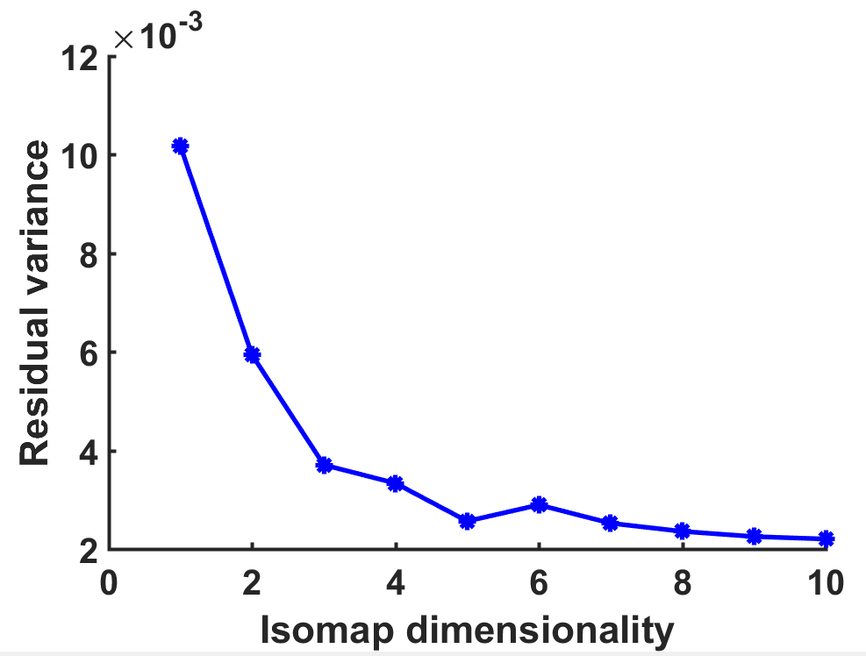
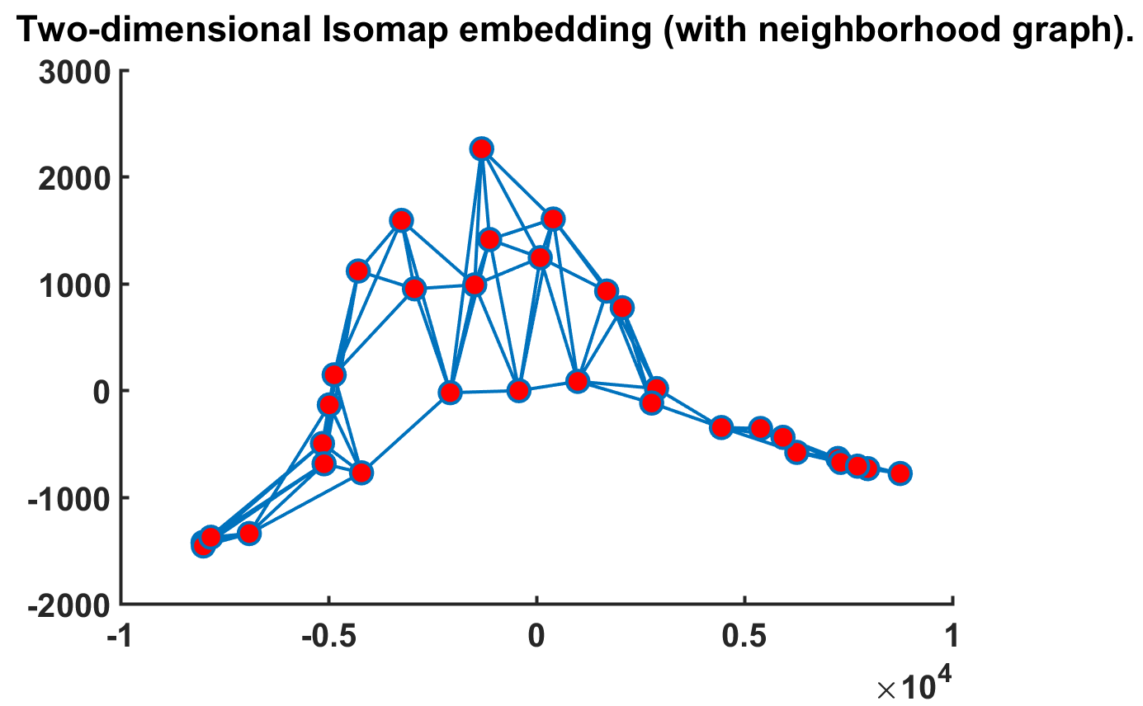
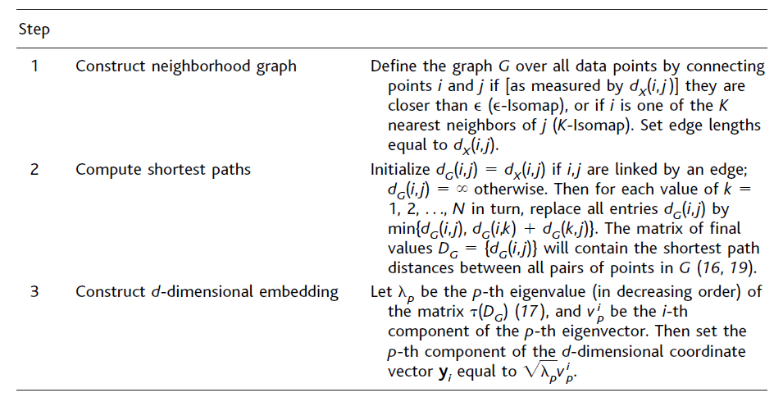
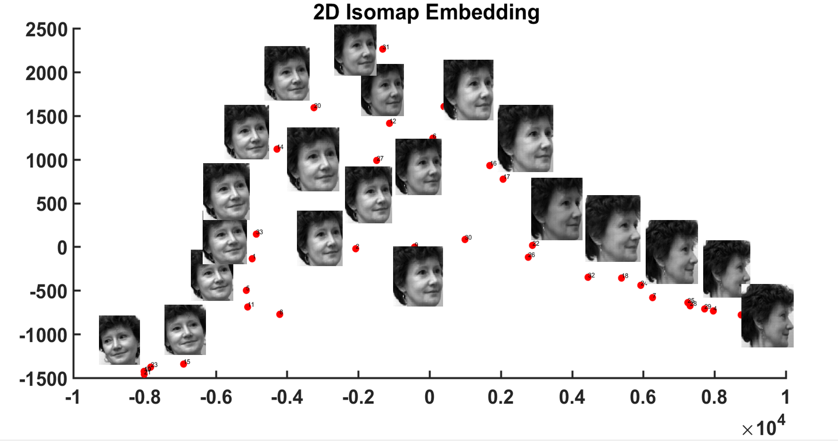
Isomap-embedding: algorithm & results
Algorithm
Results
CSIC 5011 Final project SUN Jing, LUO Shuang, YU Zhijie 5

Slide 6
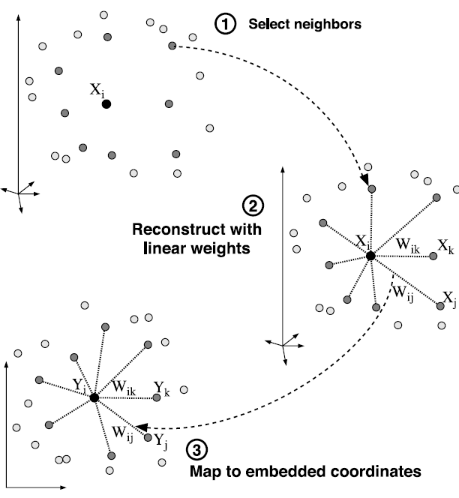
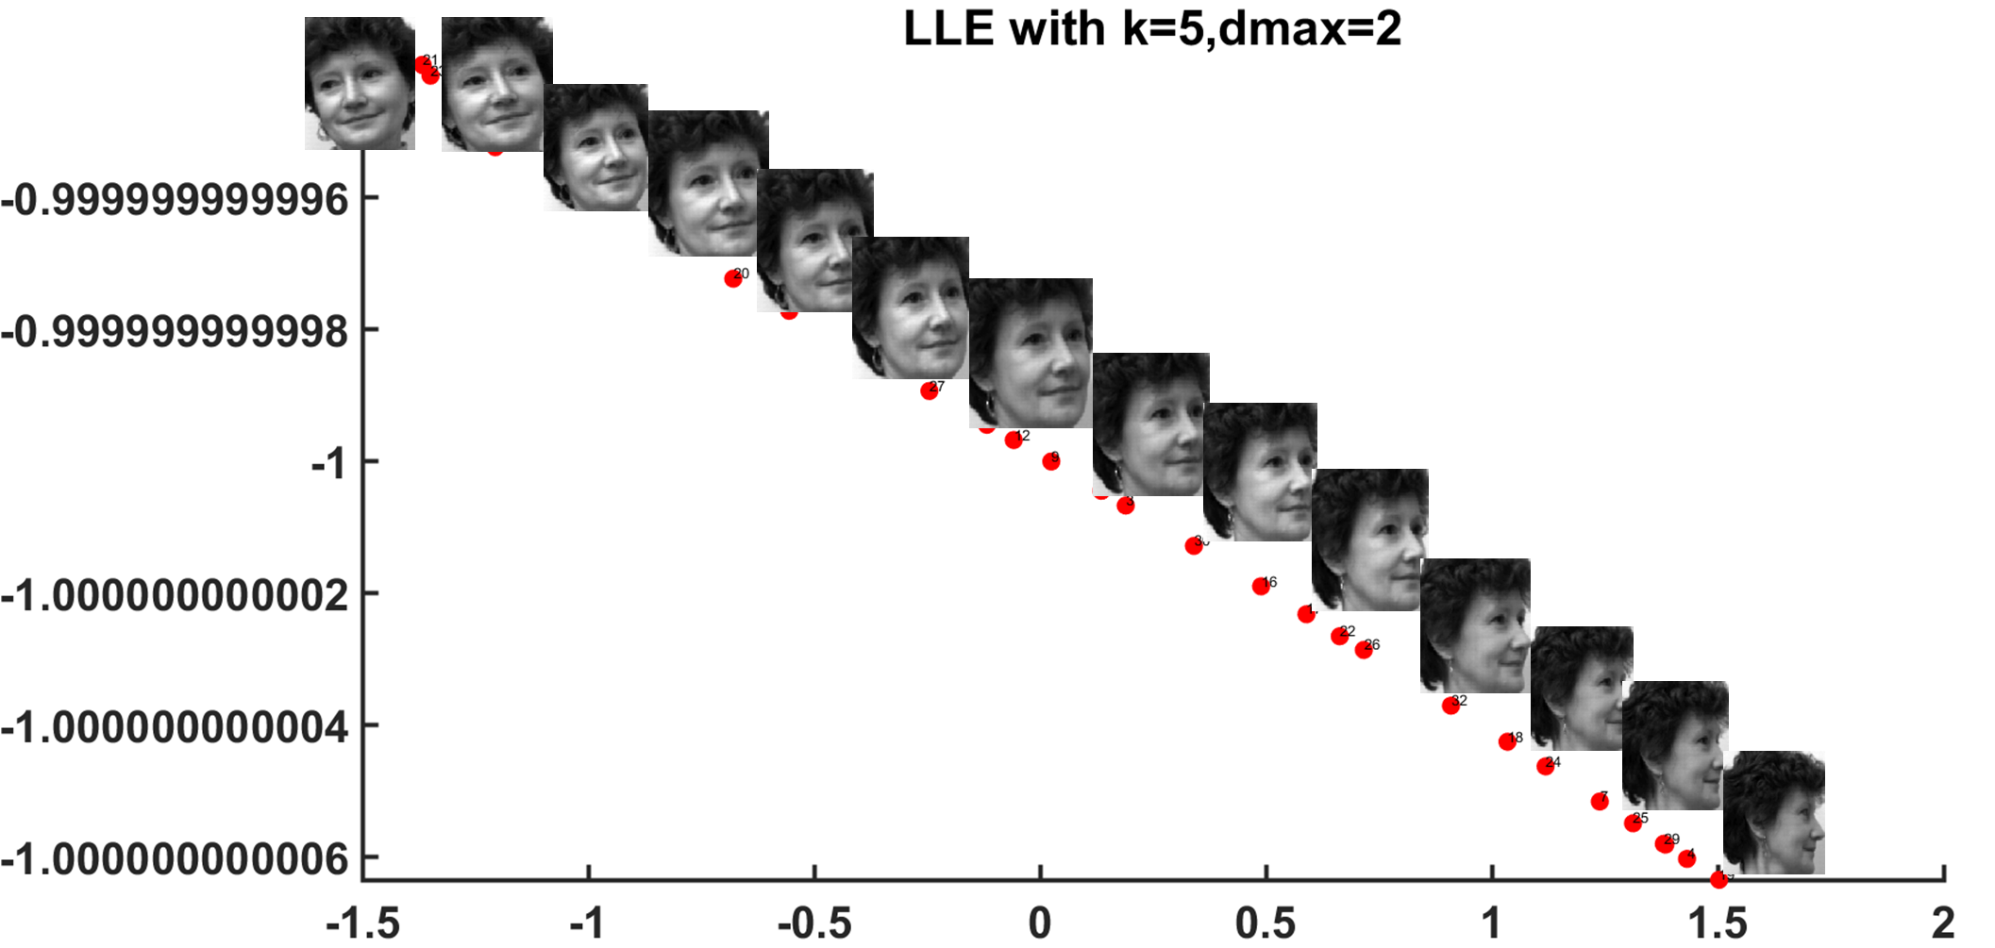
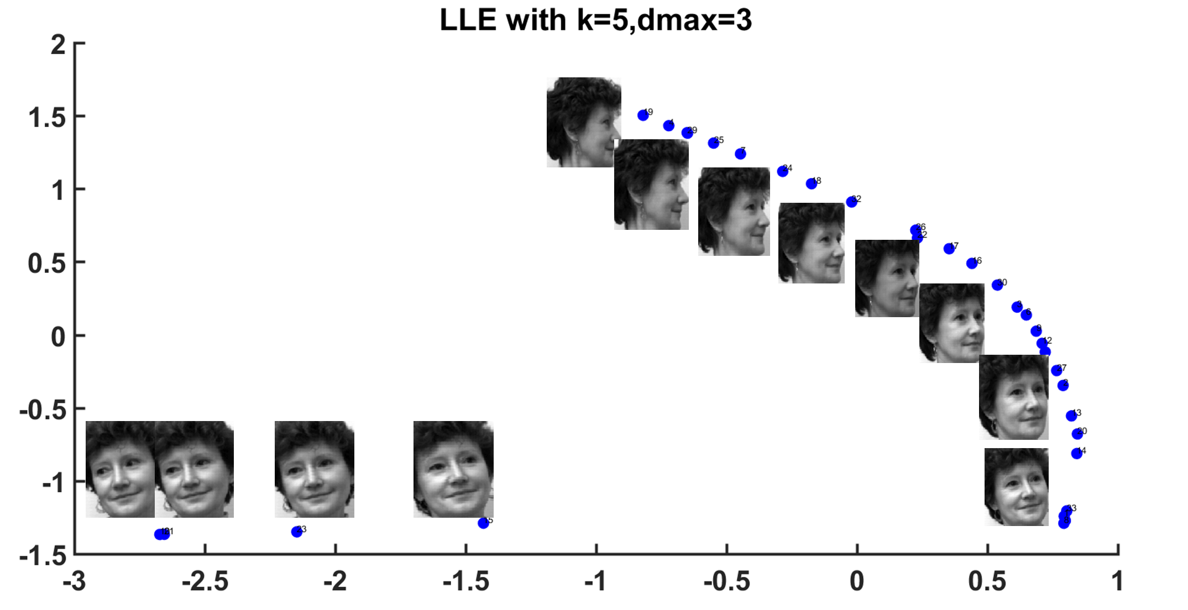
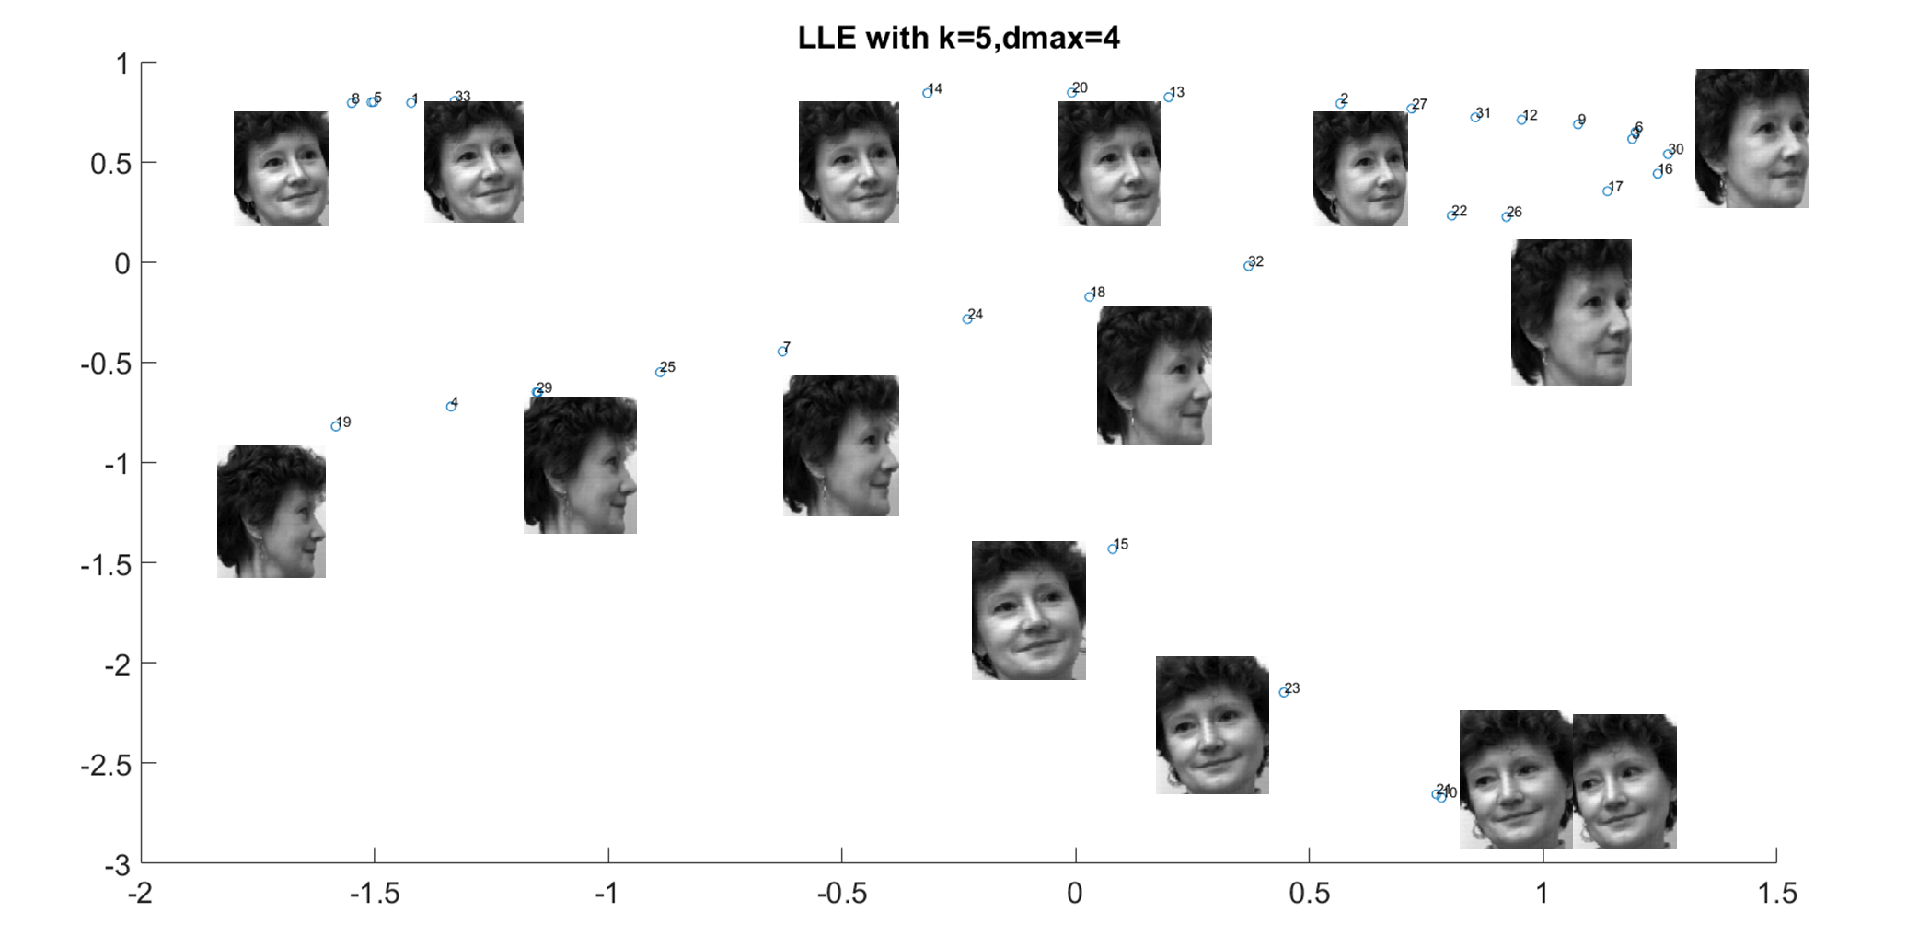
LLE-embedding: algorithm & results
Algorithm
Results
CSIC 5011 Final project SUN Jing, LUO Shuang, YU Zhijie 6

Slide 7
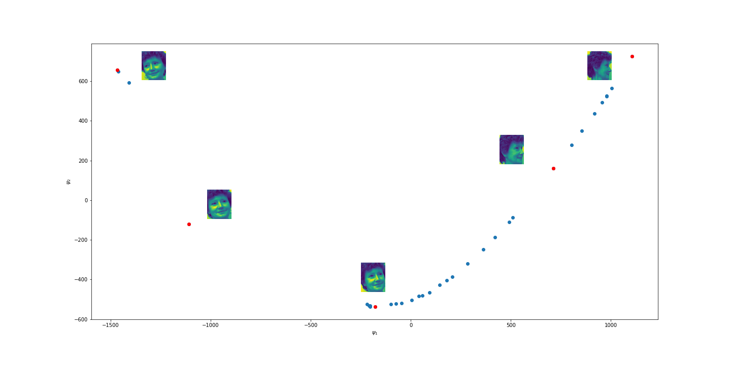
Diffusion Map: algorithm & results
Algorithm
Results
Step 1: Given the similar matrix
Step 2: Normalize the matrix
Step 3: Form the normalized matrix
Step 4: Compute the k largest eigenvalues of
and the corresponding eigenvectors
Step 5: Use diffusion map to get the embedding
CSIC 5011 Final project SUN Jing, LUO Shuang, YU Zhijie 7

Slide 8
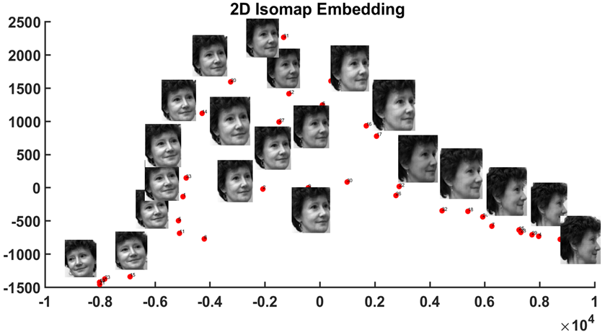
Summary
CSIC 5011 Final project SUN Jing, LUO Shuang, YU Zhijie 8

Slide 9
Thanks for your attention !

