Slide 1
Lecture 12: Applications of Deep Learning with Torch
Yuan Yao
Peking University

Slide 2
Neural Style by J C Johnson
Website: https://github.com/jcjohnson/neural-style
A torch implementation of the paper
A Neural Algorithm of Artistic Style,
by Leon A. Gatys, Alexander S. Ecker, and Matthias Bethge.
http://arxiv.org/abs/1508.06576

Slide 3
博雅塔·未名湖

Slide 4
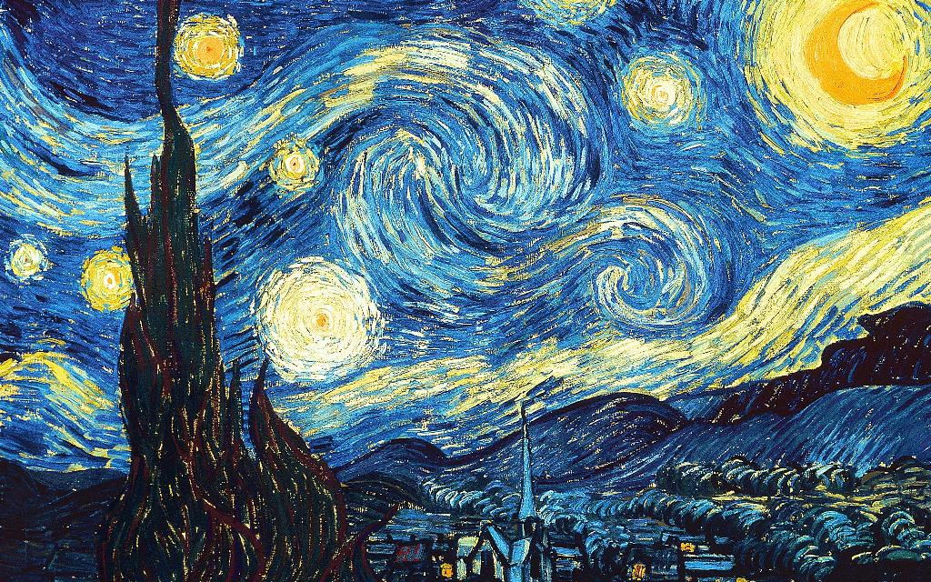
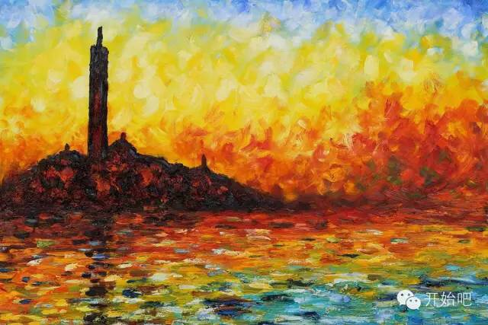
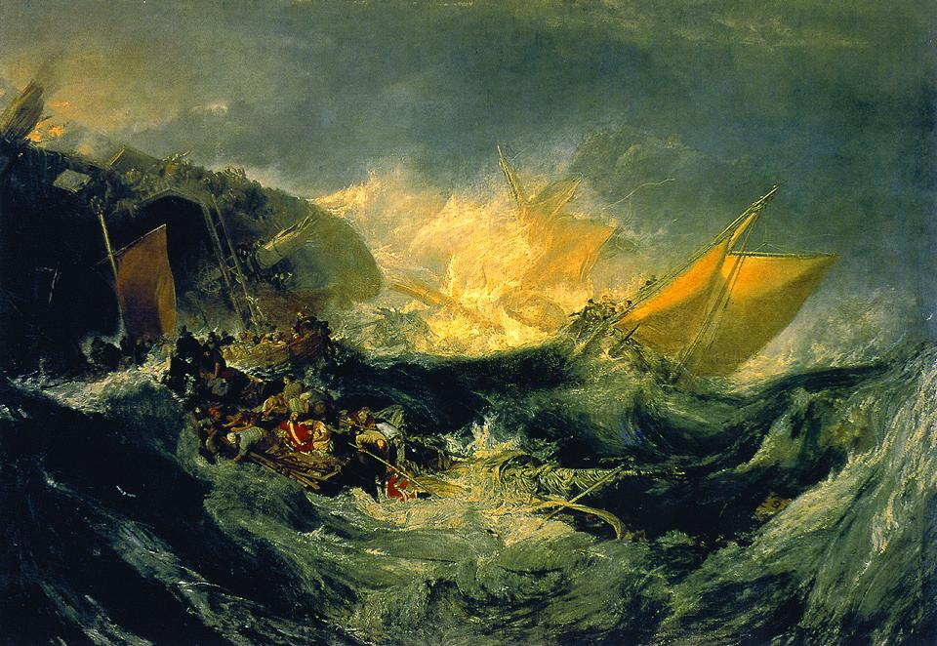
Left: Vincent Van Gogh, Starry Night
Right: Claude Monet, Twilight Venice
Bottom: William Turner, Ship Wreck

Slide 5
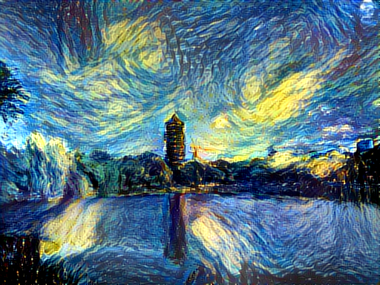
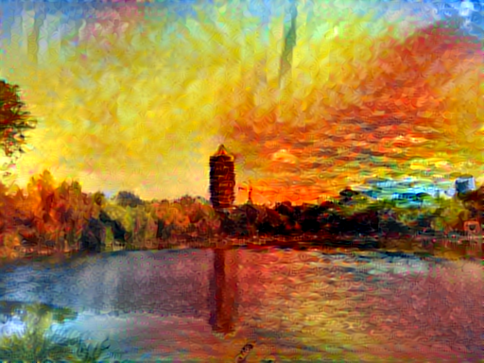
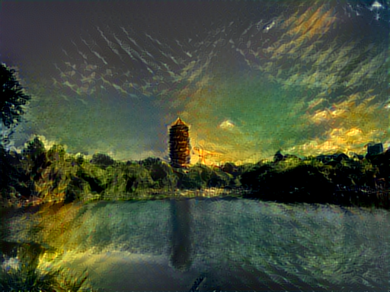
Application of Deep Learning: Content-Style synthetic pictures
By “neural-style”

Slide 6
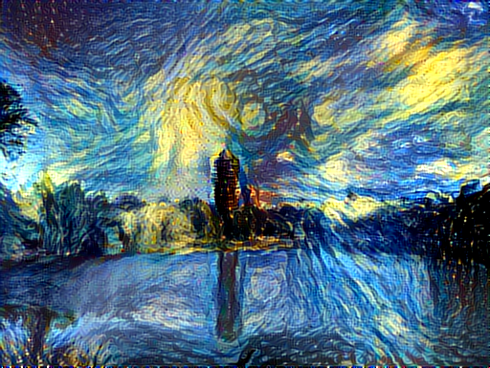
Run neural_style
ssh bicmr@bicmr2 -p 2211
cd neural-style/
th neural_style.lua -style_image examples/inputs/starry_night.jpg -content_image examples/inputs/noname.jpg -output_image examples/outputs/noname_starry.png
Different run might be different!

Slide 7
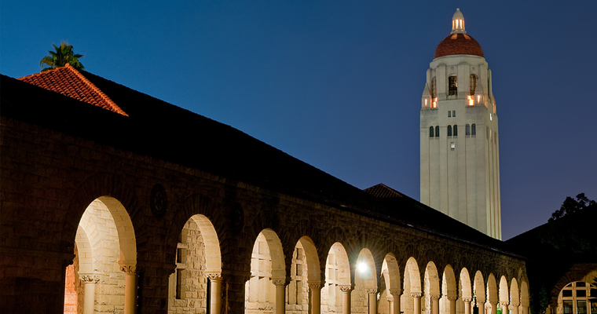
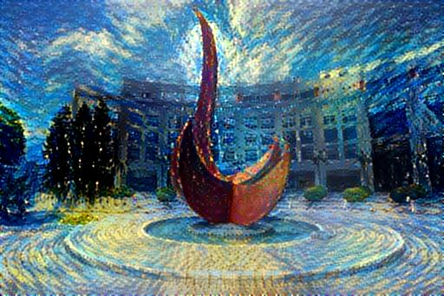
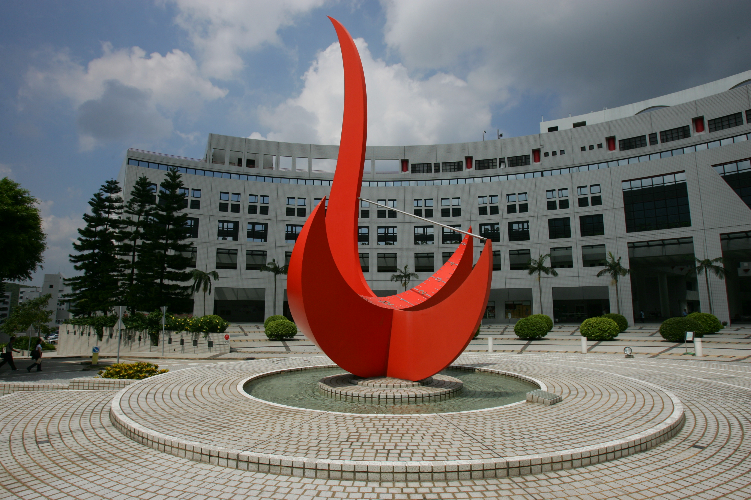

Slide 8
Style-Content Decomposition

