Slide 1
Lecture 3: Linear Regression
Yuan Yao
Peking University

Slide 2
Outline
Linear Regression
Least Square Solution
Gauss-Markov Theorem
Subset Selection
Shrinkage
Ridge Regression
LASSO, etc.

Slide 3
Linear Methods for Regression
Input (FEATURES) Vector: (p-dimensional) X = X₁, X₂, …, X_{p}
Real Valued OUTPUT: Y
Joint Distribution of (Y,X )
Model:
Regression Function E(Y |X ) = f(X)
Training Data :
(x₁, y₁), (x₂, y₂), …, (x_{N}, y_{N}) for estimation of input-output relation f.

Slide 4
Linear Model
f(x): Regression function or a good approximation
LINEAR in Unknown Parameters(weights, coefficients)

Slide 5
Features

Slide 6
Method of Least Squares
Find coefficients that minimize
Residual Sum of Squares, RSS(β) =
RSS denotes the empirical risk over the training set. It doesn’t assure the predictive performance over all inputs of interest.

Slide 7
Optimal Solution
The Hession (2nd derivative) of the criterion function is given by X^{T}X.
The optimal solution satisfies the normal equations
X^{T}(Y-X β) = 0 or (X^{T}X) β = X^{T}Y
For an unique solution, the matrix X^{T}X must full rank.

Slide 8
Projection
When the matrix X^{T}X is full rank. the estimated response for the training set:
H: Projection (Hat) matrix
: Orthogonal Projection of Y on the space spanned by the columns of X
Note: the projection is linear in Y

Slide 9
Geometrical Insight

Slide 10
Statistics Properties of LS
Model
Uncorrelated noise: Mean zero, Var
Then
Noise estimation
Model d.f. = p+1 (dimension of the model space)
To draw inferences on parameter estimates, we need assumptions on noise:
If assume:
then,

Slide 11
Various Types of Inference
Hypothesis test
one parameter : t-test
two or more parameters: F-test for nested models
Confidence sets
Interval estimates
Confidence ellipsoids

Slide 12
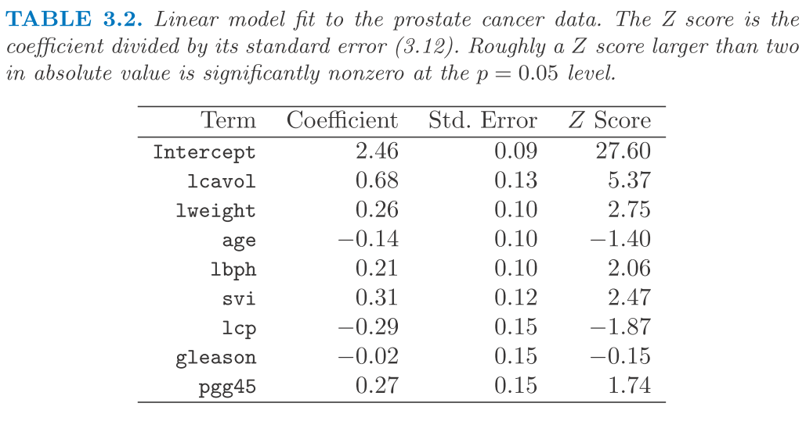
Example: Prostate Cancer
Data: 97 = 67+30 patients
Response:
Log of Prostate-specific Antigen (lpsa)
Features:
Log cancer volume
Log prostate weight
Age
Log of benign prostate hyperplasia
Seminal vesicle invasion
Log of capsular penetration
Gleason scores
Percentage of gleason score 4,5

Slide 13
Gauss-Markov Theorem
Among all unbiased linear estimator,
the least square estimator has the smallest variance
Bias-Variance Decomposition
It is possible to trade in bias for a smaller MSE than least square: Stein’s inadmissibility and Shrinkage

Slide 14
When the Least Square Method fails?
N<p?
X : rank deficient
Normal equations has infinitely many solutions
Hat matrix H, and the projection are unique.
For an input in the row space of X, unique LS estimate.
For an input, not in the row space of X, the estimate may change with the solution used.
How to generalize to inputs outside the training set?

Slide 15
Reasons for Alternatives to LS Estimates
Prediction accuracy
LS estimates have low bias but high variance when inputs are highly correlated
Larger ESPE
Prediction accuracy can sometimes be improved by shrinking or setting some coefficients to zero.
Small bias in estimates may yield a large decrease in variance
Bias/var tradeoff may provide better predictive ability (Stein’s Phenomena)
Better interpretation
With a large number of input variables, like to determine a smaller subset that exhibit the strongest effects.
Many tools to achieve these objectives
Subset selection
Penalized regression -constrained optimization

Slide 16
Best Subset Selection Method
Algorithm: leaps & bounds
Find the best subset corresponding to the smallest RSS for each size
For each fixed size k, can also find a specified number of subsets close to the best
For each fixed subset, obtain LS estimates
Feasible for p ~ 40.
Choice of optimal k based on model selection criteria to be discussed later (CV, AIC, BIC etc.)

Slide 17
Other Subset Selection Procedures
Forward selection (step-up),
Backward elimination (step down)
Hybrid forward-backward (step-wise) methods
Given a model, these methods only provide local controls for variable selection or deletion
Which current variable is least effective (candidate for deletion)
Which variable not in the model is most effective (candidate for inclusion)
Do not attempt to find the best subset of a given size
Not too popular in current practice

Slide 18
Forward Stagewise Selection
(Incremental) Forward stagewise
Standardize the input variables
Note:
Similar to OMP (Orthogonal Matching Pursuit), but with a more careful step-size control

Slide 19
Penalized Regression
Instead of directly minimize the Residual Sum Square,
The penalized regression usually take the form:
where J(f) is the penalization term, usually penalize on
the smoothness or complexity of the function f

Slide 20
Ridge Regression
Ridge regression shrinks coefficients by imposing a penalty on their size
Min a penalized RSS
Here is complexity parameter, that controls the amount of shrinkage
Larger its value, greater the amount of shrinkage
Coefficients are shrunk towards zero
Choice of penalty term based on cross validation
The Ridge criterion
Sol:
For orthogonal inputs, ridge: scaled version of LS estimates
Ridge is mean or mode of posterior distribution of under a normal prior

Slide 21
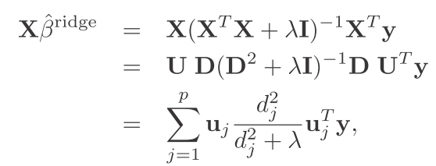
Ridge Regression and Principal Components
First PC direction :
Among all normalized linear combinations of columns of X, the has largest sample variance
Derived variable, is first PC of X.
Subsequent PC have max variance, subject to being orthogonal to earlier ones. Last PC has min variance
Effective Degree of Freedom
Centered input matrix X
SVD of X:
U and V are orthogonal matrices
Columns of U span column space of X
Columns of V span row space of X
D: a diagonal matrix of singular values
Eigen decomposition of
The Eigen vectors : principal components directions of X (Karhunen-Loeve direction)

Slide 22
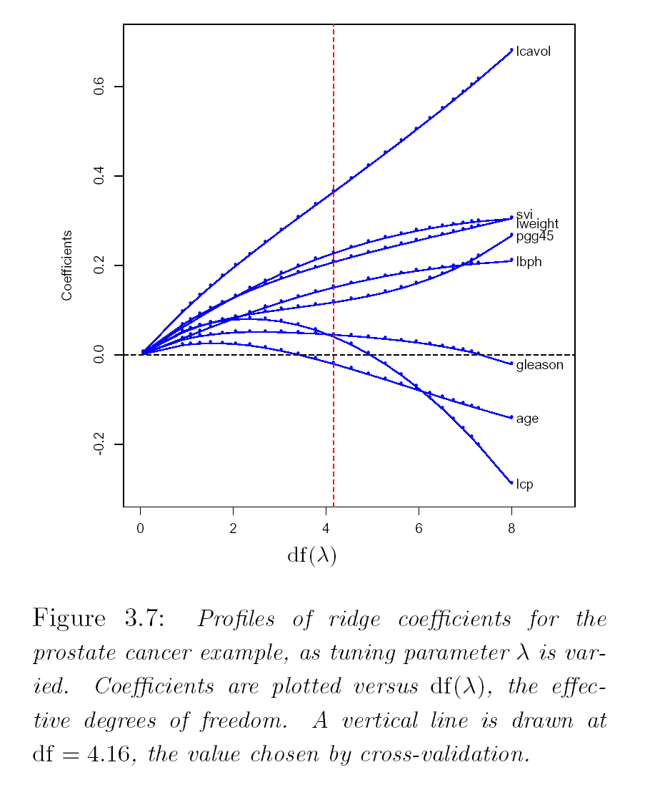
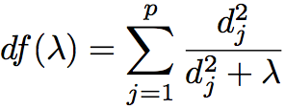
Prostate Cancer Example

Slide 23
Ridge Regression (Summary)
Ridge Regression penalized the complexity of a linear model by the sum of squares of the coefficients
It is equivalent to minimize RRS given the constraints
The matrix (X^{T}X+ λI) is always invertible.
The penalization parameter λ controls how simple “you” want the model to be.

Slide 24
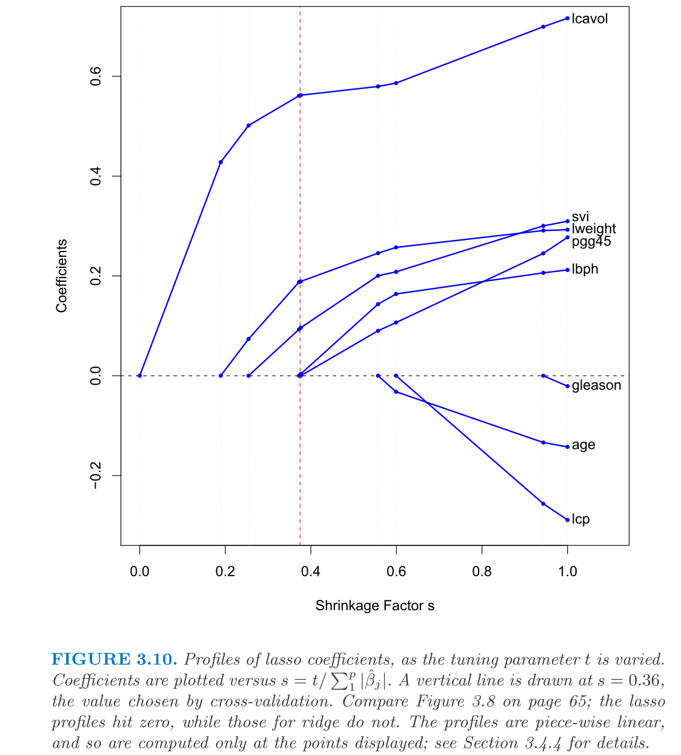
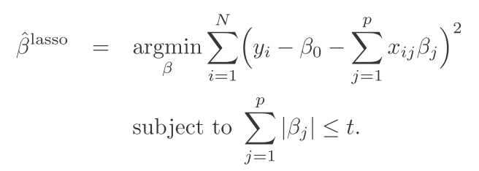
LASSO
Lagrangian Form
Constraint form (Basis Pursuit)

Slide 25
Comparisons

Slide 26
Why LASSO favors Sparse Estimators than Ridge?

Slide 27
Elastic Net Penalty and Lq

Slide 28
Homework
3.1, 3.3, 3.5, 3.7, 3.12, 3.20, 3.23, 3.27

